Slide 1


NLP Final Project
Twitter Sentiment Analysis on FIFA World cup 2022
By: Ayushi Chauhan

Slide 2
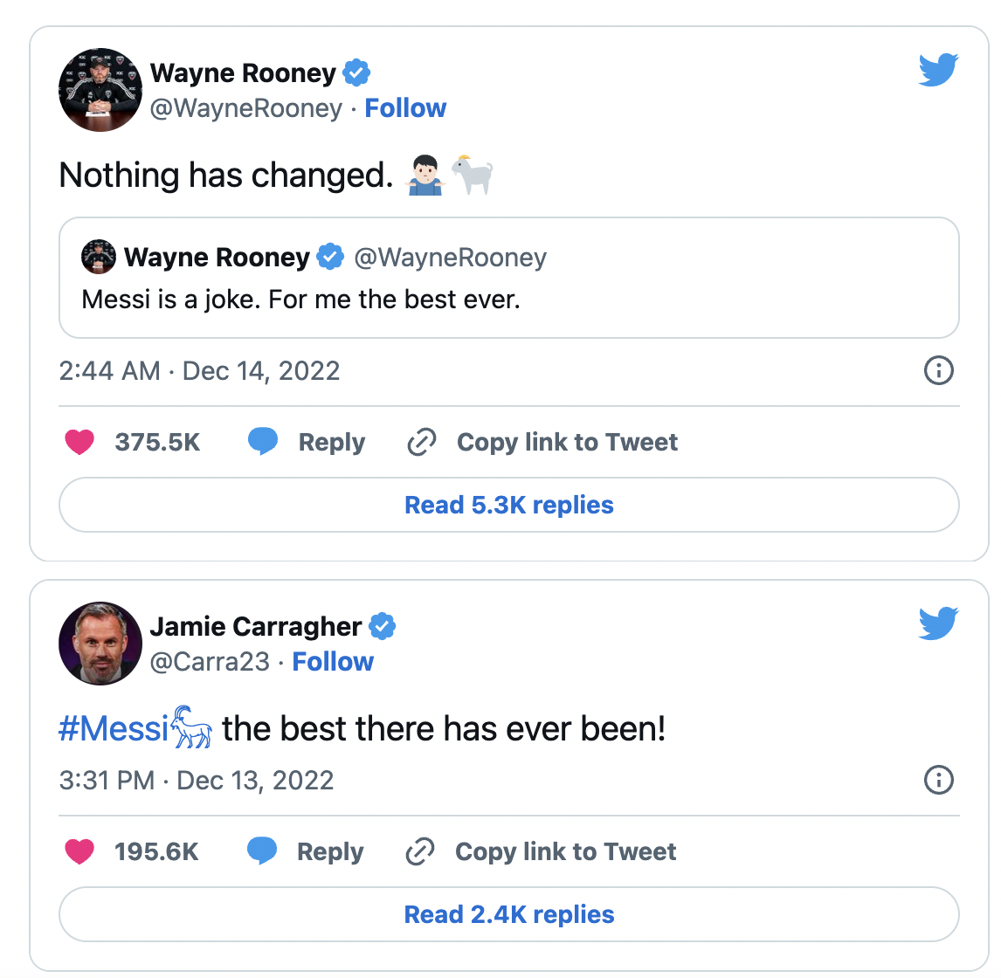
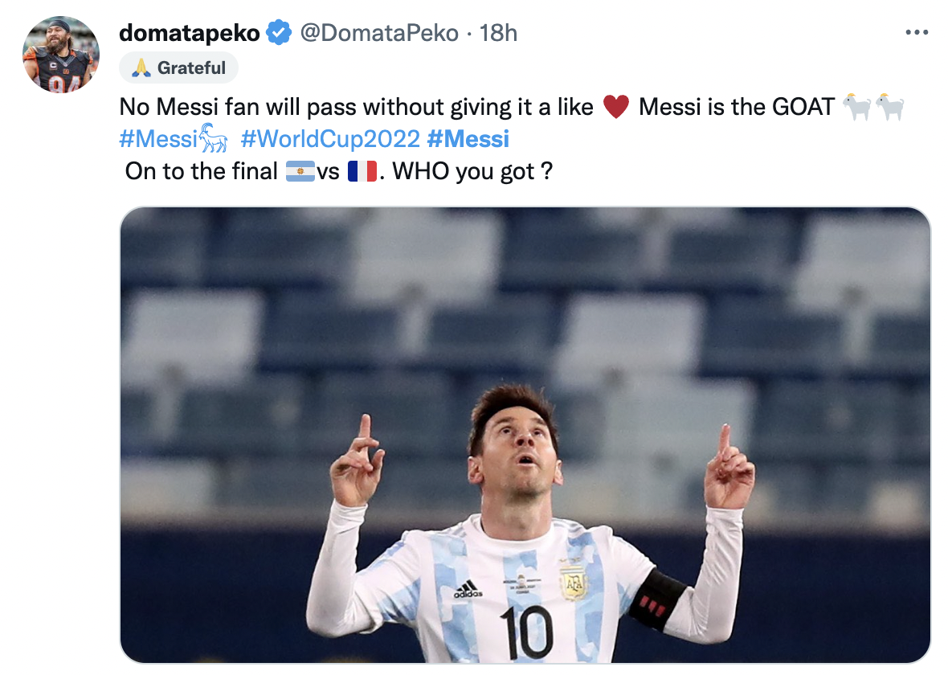
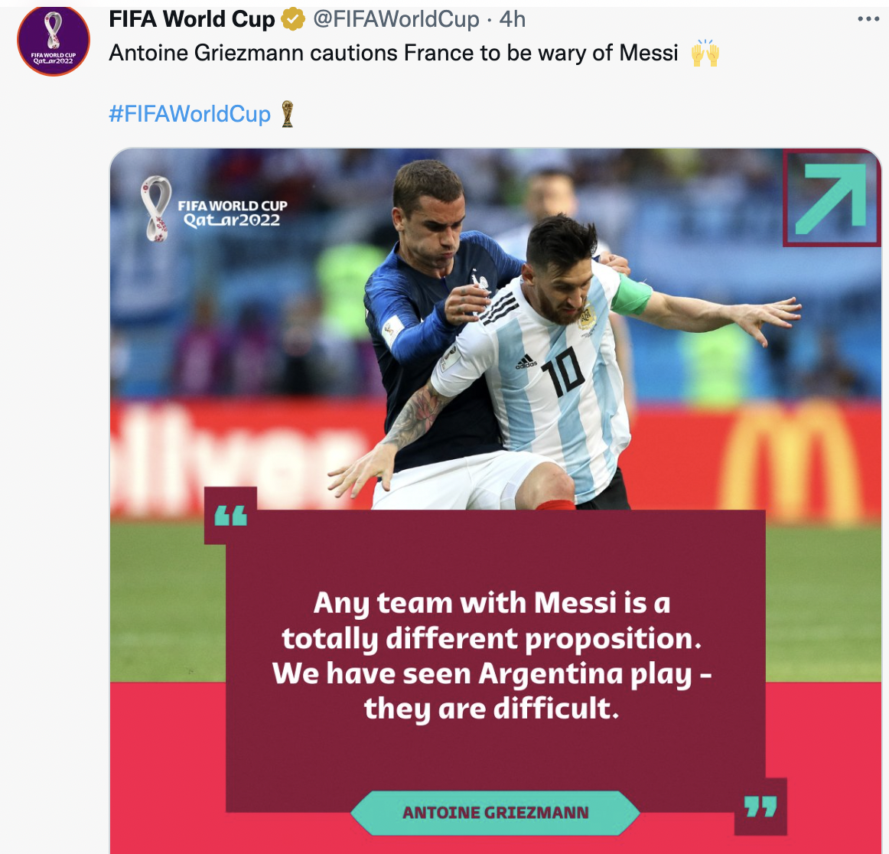
Background
The 2022 World Cup in Qatar, which kicked off November 20, is the most expensive World Cup ever, with costs reaching $220 billion.
Brazil extended its lead over second-placed Belgium in the latest FIFA rankings released on 27 October 2022 to take the field as the top-ranked team at this year's World Cup in Qatar, starting 20 November 2022.
All eyes on Messi: Former England defender Jamie Carragher tweeted after his Lusail masterclass that Messi is "the best there has ever been".

Slide 3
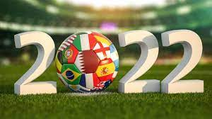
Introduction
Objective:
Perform text mining and sentiment analysis of Teams participating in the 2022 FIFA World cup by parsing tweets fetched from Twitter using Python libraries specifically designed for Tweets.
Methods:
Authorize twitter API client.
Fetch Tweets for hashtags by making a GET request to Twitter API.
Tweet parsing and classifying them as positive, negative, and neutral.
Platform and Packages:
Google Colab and explored NLTK, Tweepy and Textblob python libraries to process textual data.
tweepy is the python client for the official Twitter API
It needs permission from Twitter to elevate the Twitter Developer Account to API V2 to extract tweets, permission approved by Twitter via several Email Requests
Date Tweets extracted: 12/14/2022, day of semi-final game Argentina v.s. Croatia

Slide 4

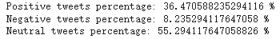
Sentiment Scoring on Selected Hashtag
Sentiment Scoring:
A key aspect of sentiment analysis is polarity classification. Polarity refers to the overall sentiment conveyed by a particular text, phrase or word. This polarity can be expressed as a numerical rating known as a “sentiment score”. For example, this score can be a number between -100 and 100 with 0 representing neutral sentiment. This score could be calculated for an entire text or just for an individual phrase.
Sentiment Scoring for hashtag - #FIFAWorldCup, 200 tweets on 12/14/200 (Code example):
tweets = api.get_tweets(query = '#FIFAWorldCup', count = 200, end_date = '2022-12-14')
# picking positive tweets from tweets
ptweets = [tweet for tweet in tweets if tweet['sentiment'] == 'positive']
# percentage of positive tweets
print("Positive tweets percentage: {} %".format(100*len(ptweets)/len(tweets)))

Slide 5
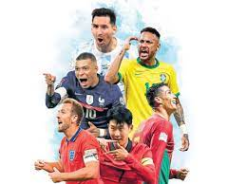
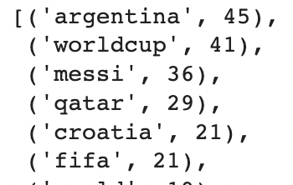
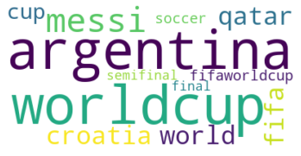
Who’s your favourite?
To understand how much a player is trending on Twitter whenever FIFA Worldcup 2022
is mentioned, the frequency of the name of the player (Messi)is calculated by following the below steps:
Extract Twitter data and remove URLs from tweets
Clean up tweet text, including differences in case (e.g. upper, lower) that will affect unique word counts and use nltk to remove words that are not useful for the analysis(Stopwords)
Summarize and count words found in tweets
Desired search: #Messi+Argentina+Worldcup+Qatar
Findings:
Top 5 useful words: Argentina, Worldcup, Messi, Qatar, Croatia, FIFA

Slide 6
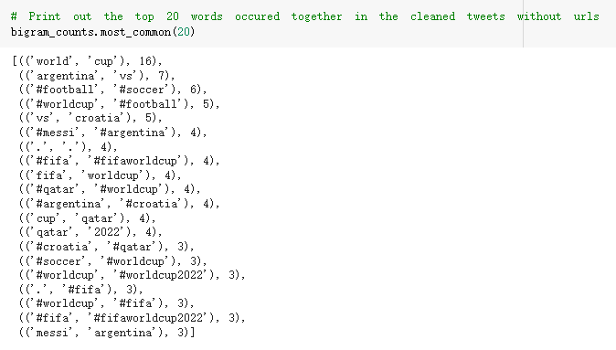
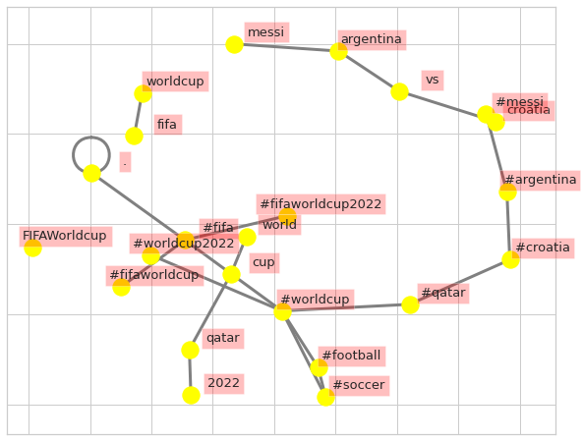
Co-occurring Words (Bigrams)
Use Bigram function to identify the words often occur together in those cleaned tweets to help us do sentiment analysis.
Bigrams is a function contained in NLTK
correlationship of the bigram words is described by the connected nodes
high dimensional relationship of a group of words is shown in the centre of the bigram
two words connected by the node means they occur together in those tweets we extract and processed

Slide 7
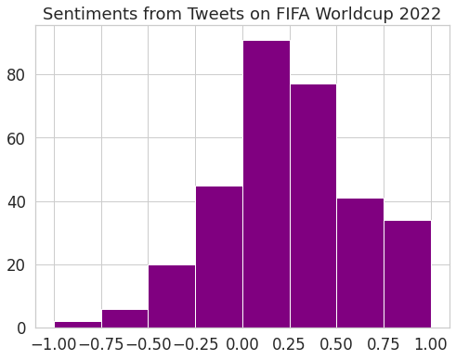
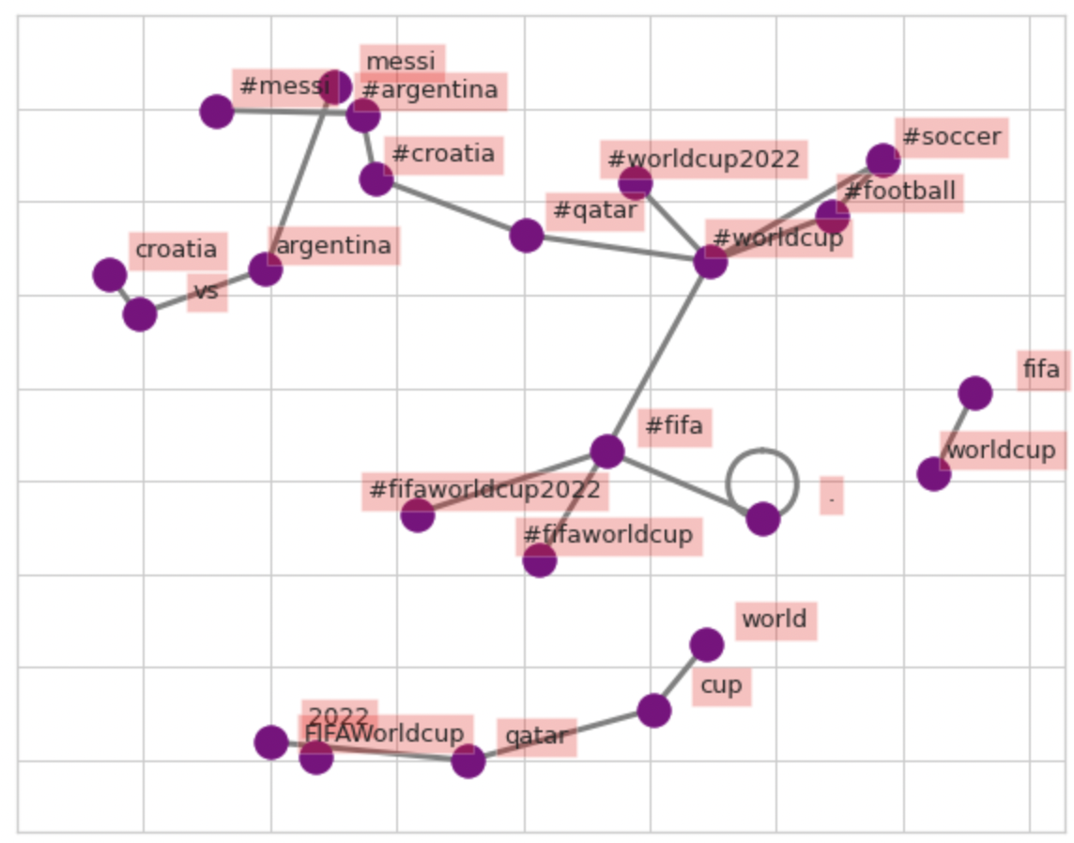
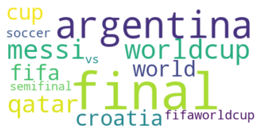
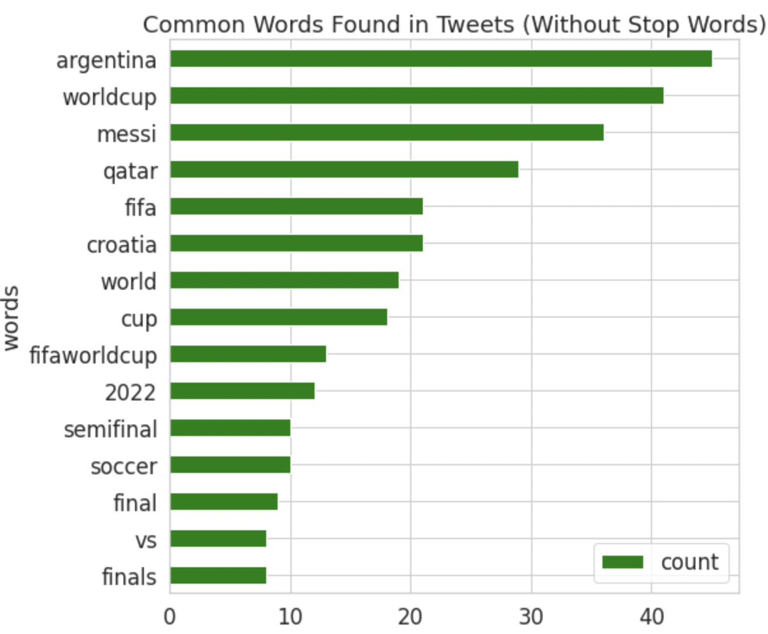
Visualization
Visualizations in the form of Wordcloud, histogram plots, network diagram and bar plots while exploring Seaborn, matplot, networkx, Wordcloud libraries

Slide 8
Conclusion
Sentiment Analysis can gain the corporations insights from related industries
Sentiment Scoring on social media like Twitter can explain about the public’s thoughts for a specific event like FIFA World Cup by the three percentage ranks: Positive, Negative, Neutral
Stop Words need to be removed from the Word List when we try to do sentiment analysis about the frequency of words
Bigram can help us know the words that usually occur together for the specific event
Insights from Analysis done on this project:
The words we processed with frequency counts might allow us to suggest to the corporations in the related industries are like those sports brands sell the clothes including those for argentina, croatia, Messi. And the business corporations can do some kind of advertisement related to those worlds to gain customers and gain profit.

